Slide 1


AI-Driven Citizen Support and Complaint Management Using Natural Language Processing Course code – DSA0306 Natural Language Processing
Presented by: T. Kiran Kumar(192472321) Y. Sai kumar (192425218)
Leela Sravan kumar (192425272)
A Mohith Krishna (192425199)
K Varshan (192325089)
Guided by – T. Kumaragurubaran

Slide 2
Introduction
Government agencies receive thousands of citizen complaints every day through websites, mobile apps, emails, and social media.
Manual complaint handling is slow, time-consuming, and prone to delays and errors.
Artificial Intelligence (AI) combined with Natural Language Processing (NLP) enables computers to understand, analyze, and process human language.
The proposed system automatically understands citizen complaints, categorizes them, identifies urgency, routes them to the appropriate department, and provides instant responses.
This improves transparency, efficiency, citizen satisfaction, and overall public service delivery.

Slide 3
Objectives
To Develop an AI-based citizen complaint management system using NLP.
To Automatically classify complaints into relevant government departments.
To Detect complaint priority and urgency using sentiment and text analysis.
To Identify duplicate or similar complaints to reduce redundant processing.
To Provide multilingual support for citizens.
To Generate automated acknowledgments and responses using AI.
To Track complaint status and provide real-time updates.
To Improve complaint resolution efficiency, transparency, and citizen satisfaction.

Slide 4


Existing System
Citizens submit complaints through websites, mobile apps, phone calls, or help desks.
Complaints are generally stored and processed manually.
Complaint category and department are often selected manually.
Text-based complaints are mainly handled as simple text records.
Images or videos are generally used only as supporting evidence.
Duplicate complaints may be registered as separate cases.
Priority is often assigned based on manual assessment.
Limited AI-based analysis and city-level intelligence is available.
This can result in delays, repeated work, and inefficient resource allocation.

Slide 5
Problem Statement
Existing complaint management systems rely heavily on manual processing.
Complaints submitted in different languages and writing styles are difficult to analyze quickly.
Delays in complaint classification and forwarding increase resolution time.
Duplicate complaints waste administrative resources.
Lack of real-time status updates reduces citizen trust.
There is a need for an intelligent system that can automatically understand, classify, prioritize, and manage citizen complaints using NLP techniques.

Slide 6
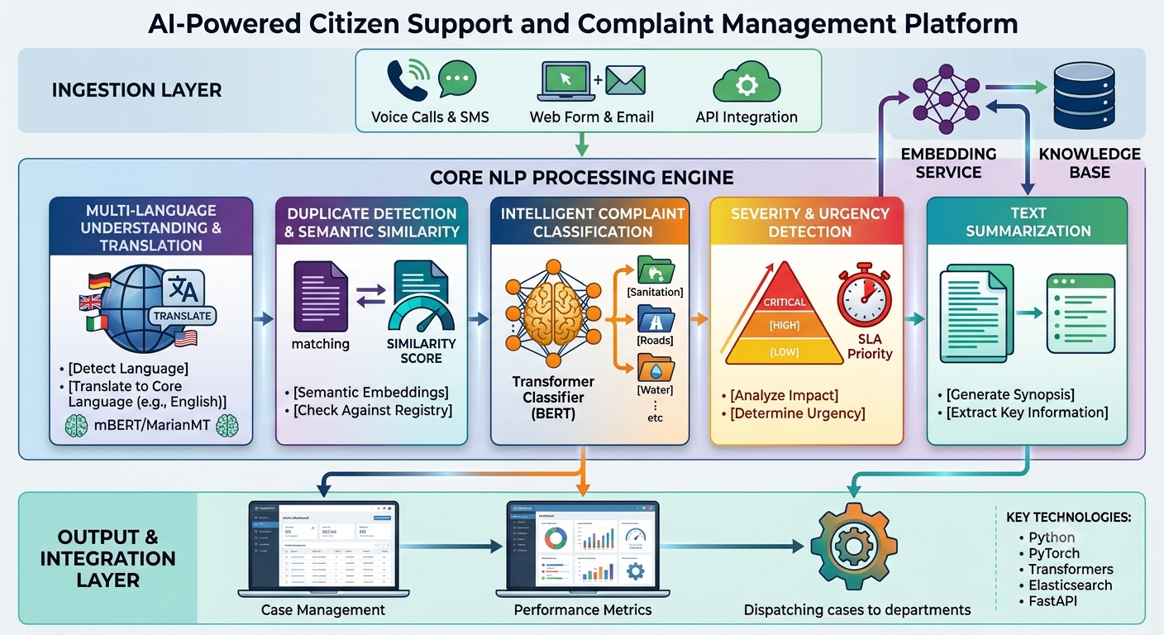
Architecture Diagram

Slide 7
Module 1: Intelligent Complaint Classification using Transformer Models
Novelty: Automatically categorizes complaints into departments (Water, Electricity, Roads, Sanitation, etc.) using advanced NLP models like BERT or DistilBERT instead of simple keyword matching.
Working:
The citizen enters a complaint.
The BERT model analyzes the text and understands its context.
The complaint is automatically classified into the correct department (Water, Roads, Electricity, Sanitation, etc.).
The complaint is forwarded to the respective department.
Uses:
Text classification.
Improves routing accuracy.
Reduces manual effort.

Slide 8
Module 2: Complaint Severity and Urgency Detection
Novelty: Automatically identifies the urgency of a complaint by analyzing its sentiment and emotional tone, ensuring critical issues are handled first.
Working:
The citizen submits a complaint.
The sentiment analysis model evaluates the text.
The system assigns a priority level (Low, Medium, High, or Critical).
High-priority complaints are forwarded for immediate attention.
Uses:
Sentiment analysis.
Priority prediction.
Faster emergency response.

Slide 9
Module 3 : Multi-language Complaint Understanding and Translation
Novelty: Allows citizens to submit complaints in regional languages and automatically translates them into a common language while preserving the original meaning.
Working:
The citizen submits a complaint in any supported language.
The translation model detects the language.
The complaint is translated into English (or another common language).
The translated complaint is processed by the system.
Uses:
Machine translation.
Language identification.
Supports multilingual communication.

Slide 10
Module 4: Duplicate Complaint Detection using Semantic Similarity
Novelty: Detects duplicate complaints by comparing the meaning of new complaints with existing ones instead of matching only exact words.
Working:
A new complaint is submitted.
The semantic similarity model compares it with previous complaints.
If the similarity score is high, the complaint is marked as a duplicate.
Otherwise, it is registered as a new complaint.
Uses:
Semantic similarity.
Duplicate complaint detection.
Reduces redundant records.

Slide 11
Module 5: Text Summarization for Complaint Reports
Novelty: Automatically generates a short and meaningful summary of lengthy complaints, helping officials understand issues quickly.
Working:
The citizen submits a detailed complaint.
The text summarization model extracts the key points.
A concise summary is generated.
Officials review the summary before taking action.
Uses:
Text summarization.
Faster complaint review.
Improves decision-making efficiency.

Slide 12
THANK YOU

